Slide 1




AT82.02
Data Modeling and Management
Unit 2-4: Graph Model
Chutiporn Anutariya (chuti at ait dot ac dot th)

Slide 2
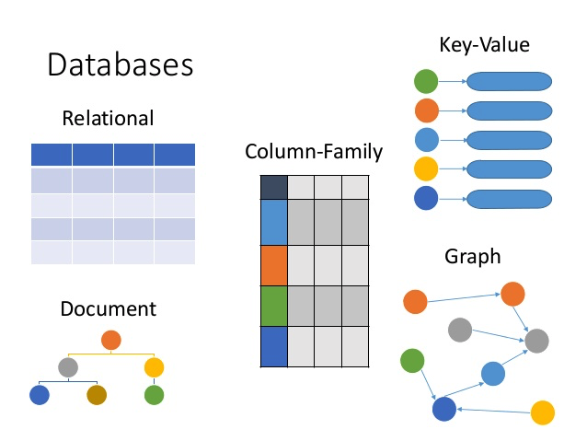
Database Family
RECAP

Slide 3

Graph Model

Slide 4
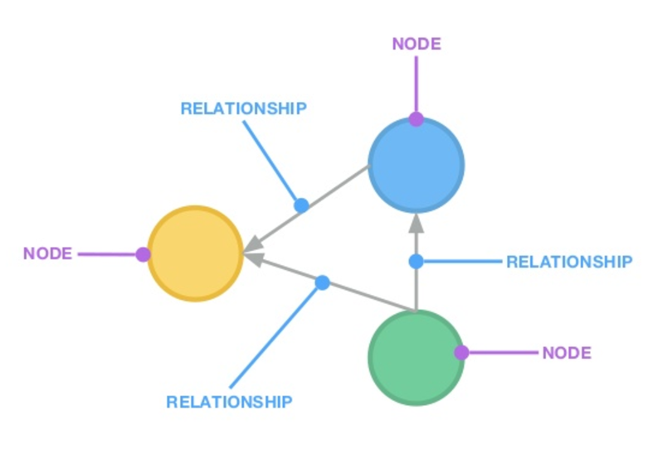
A Graph

Slide 5
Graph Model
Graph store uses graph structures for semantic queries with nodes, edges and properties to represent and store data.
The relationships allow data in the store to be linked together directly, and in many cases retrieved with one operation.
A query on a graph is known as traversing the graph.
The biggest advantage of the graph store is that joins are not necessary.

Slide 6
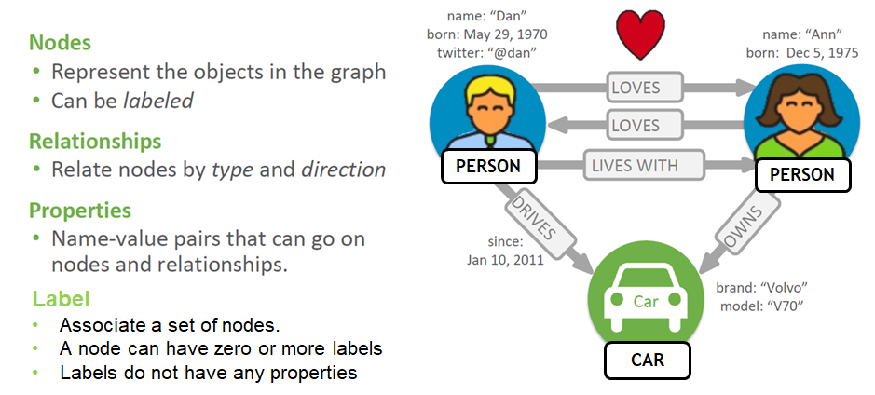
Graph Model: Property

Slide 7
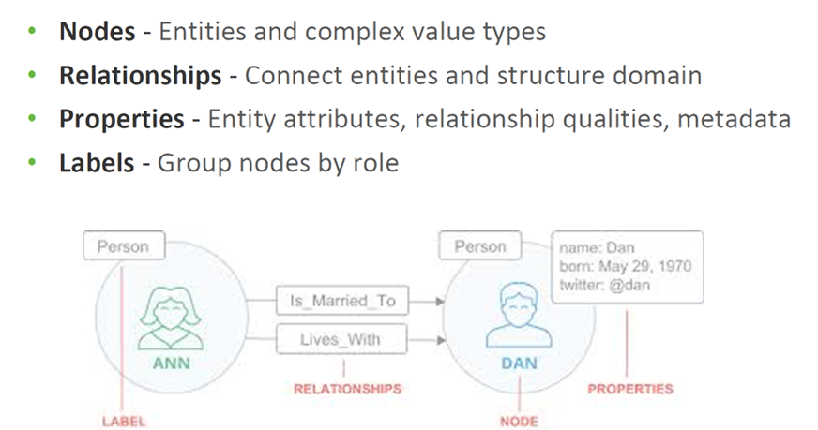
Summary: Graph Model Property

Slide 8
Cypher: (Neo4j) graph query language
uses patterns to describe graph data
familiar SQL-like clauses
declarative, describing what to find, not how to find it

Slide 9
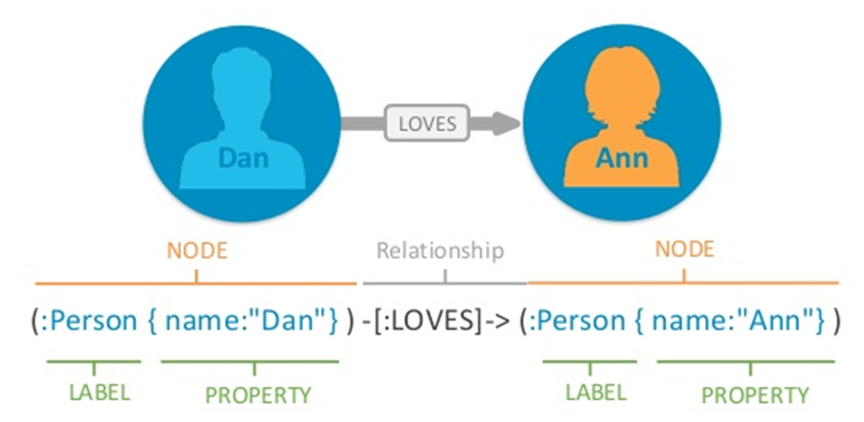
Cypher: Express Graph Patterns

Slide 10
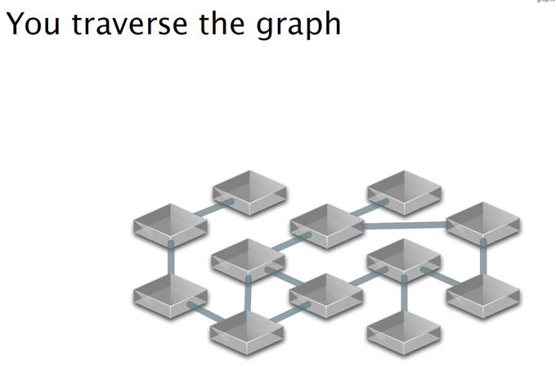
Native Graph Processing

Slide 11
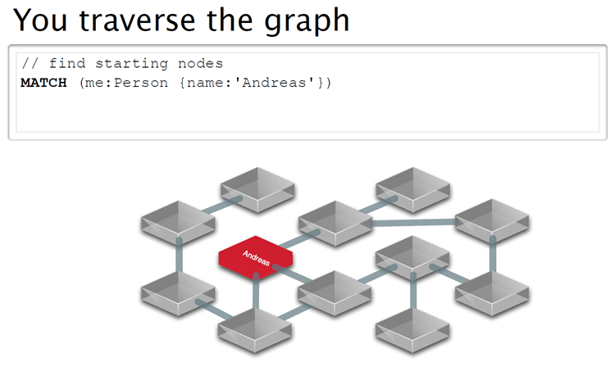
Native Graph Processing

Slide 12
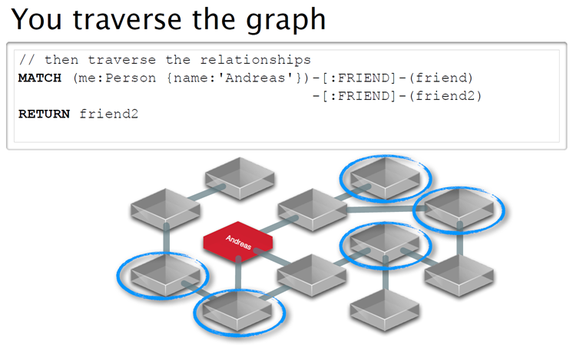
Query : friends of friend of Andreas

Slide 13
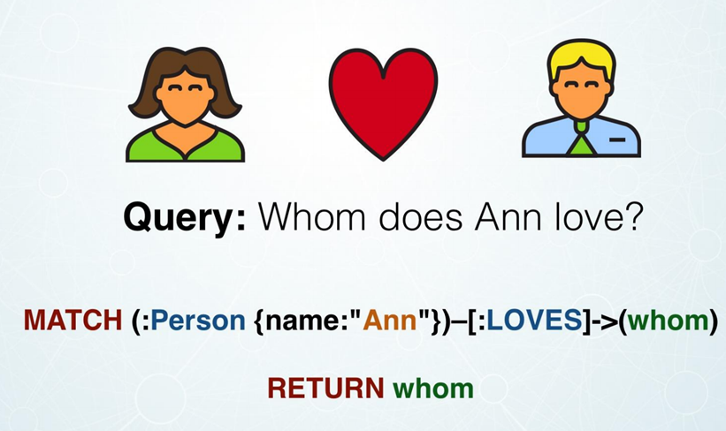
Example

Slide 14
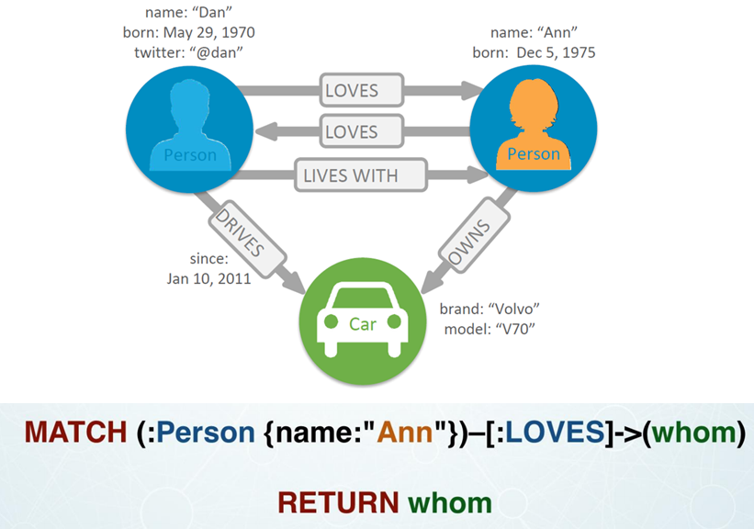
Native Graph Processing

Slide 15
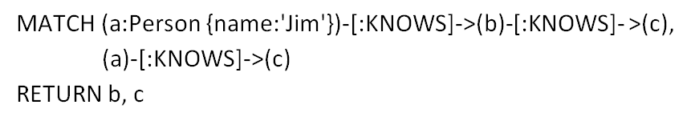
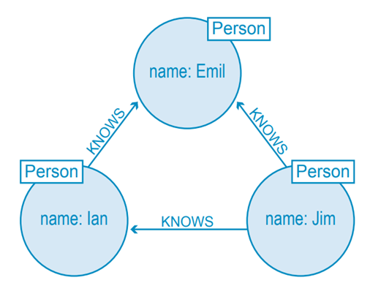
Example:

Slide 16
WHY Graph Model?

Slide 17
Relational DB Pains
Complex to model and Store relationships.
Performance degrades with increases in data.
Queries get long and complex.
Maintenance is painful.

Slide 18

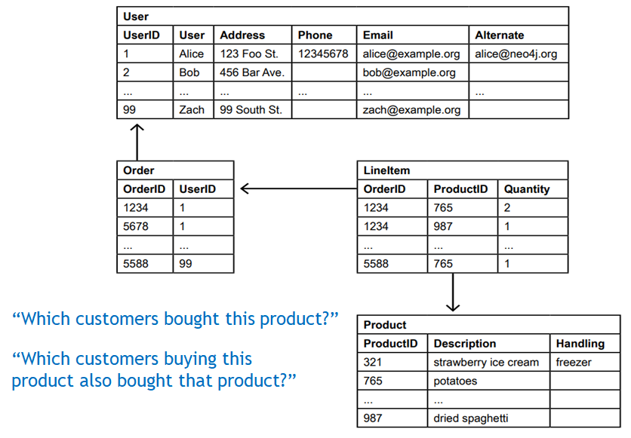
Example

Slide 19
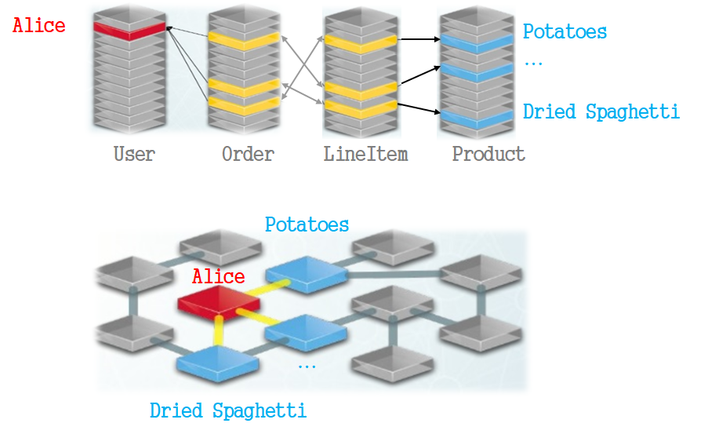
Relational vs Graph Model

Slide 20
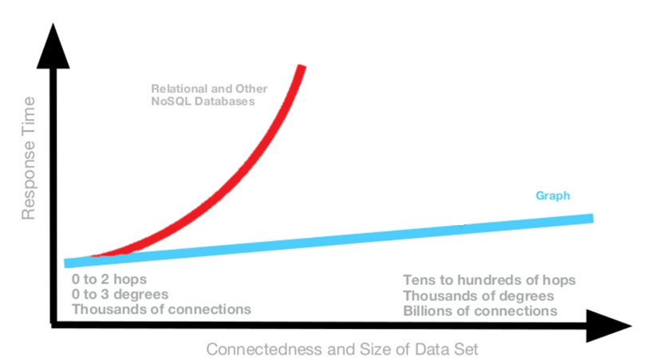
Performance degrades with increases in data.

Slide 21
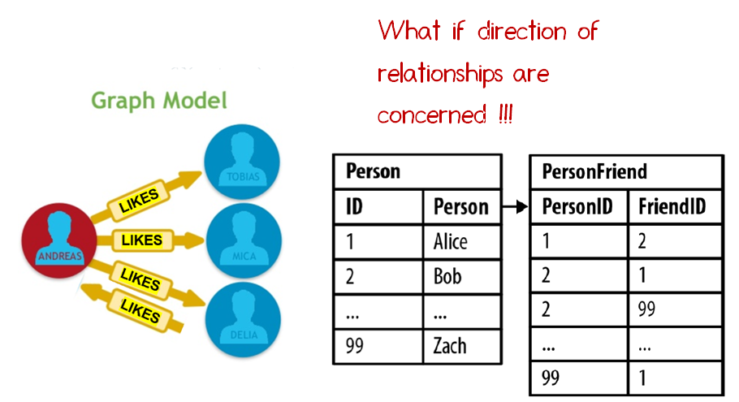
Complex to model and Store relationships.

Slide 22
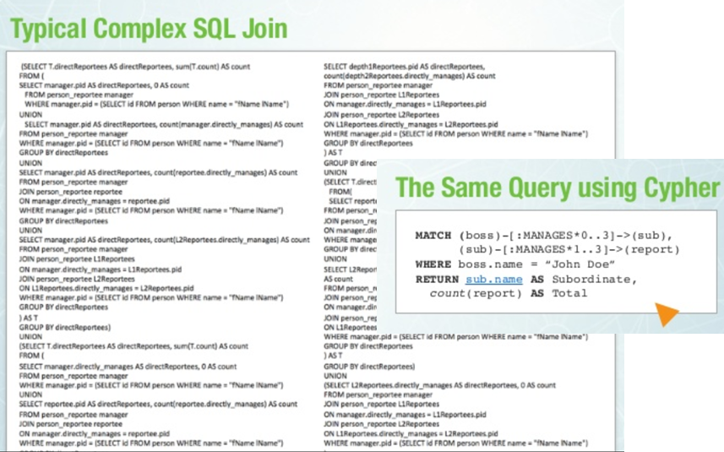
Queries get long and complex.

Slide 23
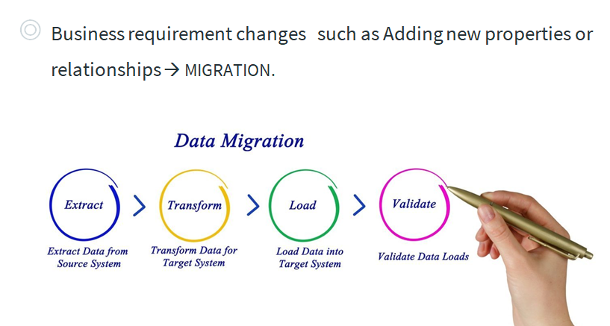
Maintenance is painful.

Slide 24
Graph Gains
Intuitiveness - Easy to model and store relationships
Speed - Performance of relationship traversal remains constant with growth in data size
Agility
Queries are shortened and more readable
Adding addition properties and relationships can be done on the fly – no migrations

Slide 25
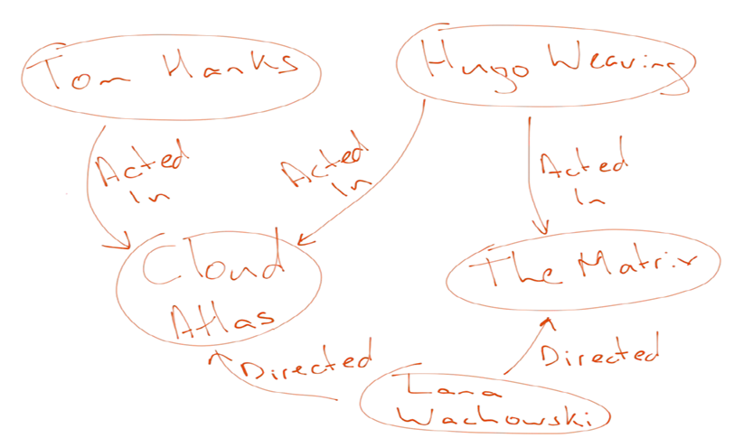
Intuitiveness
Easy to model and store relationships

Slide 26
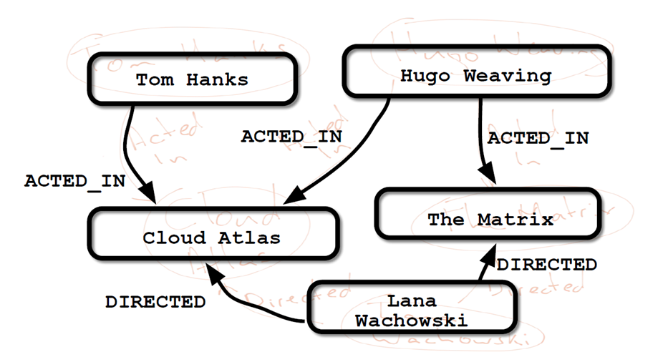
Intuitiveness
Easy to model and store relationships

Slide 27
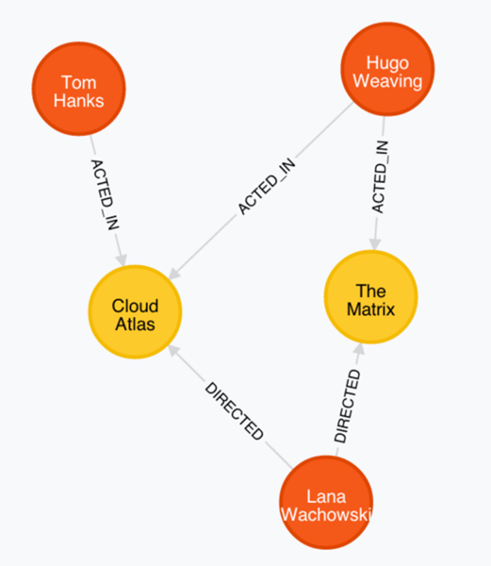
Intuitiveness
Easy to model and store relationships
Notes:
navanvadee

Slide 28
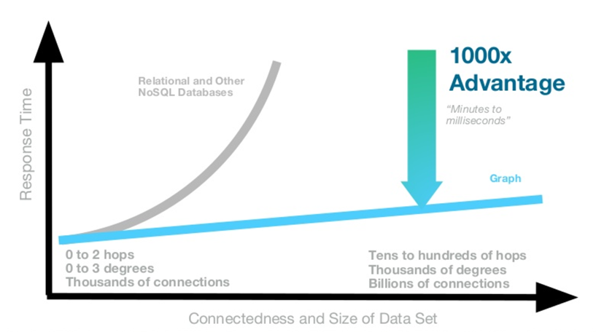
Performance of relationship traversal remains constant with growth in data size

Slide 29
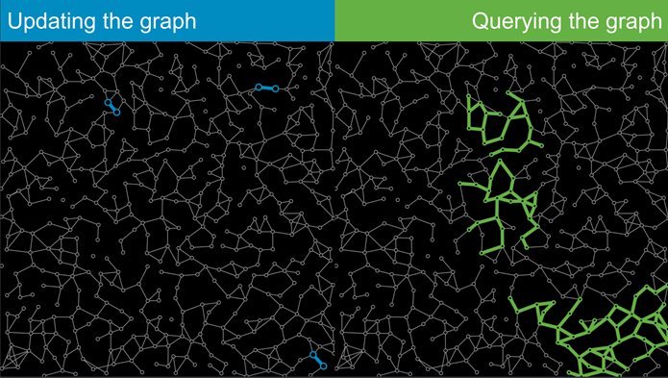
Agile
NoSQL DB allow to alter the schema without migration.
add new nodes and relationships without the process of migrating.

Slide 30
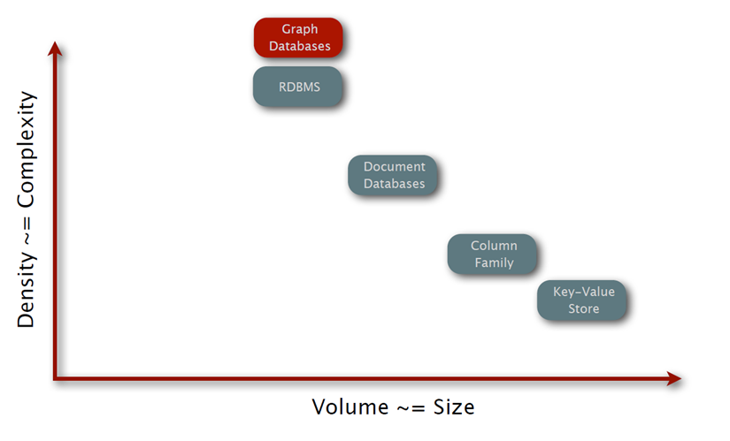
Use the Right Database for the Right Job

Slide 31

P. Sadalage and M. Fowler: NoSQL Distilled: A Brief Guide to the Emerging World of Polyglot Persistence, Addison-Wesley Professional, 2013
Jan L. Harrington: Relational Database Design and Implementation, 4th edition, Morgan Kaufmann, 2016
A. Makris, K. Tserpesa, V. Andronikou Dimosthenis Anagnostopoulos: A Classification of NoSQL Data Stores Based on Key Design Characteristics, Procedia Computer Science, Vol. 97, 2016, pp. 94-103.

